Slide 1
Data Quality and Data Security
Network Security, Fall 2019
Seth James Nielson

Slide 2
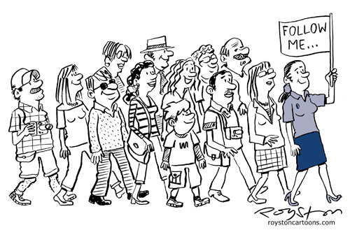
Part IV Security in a Data Context
Data Governance
Data Quality
Finally! Almost Done!
This Photo by Unknown Author is licensed under CC BY-SA-NC

Slide 3


Data Governance
Data Governance:
is the organization and implementation of policies, procedures, structure, roles, and responsibilities that outline and enforce rules of engagement, decision rights, and accountabilities for the effective management of information assets
- John Ladley, Danette McGilvray, Anne-Marie Smith, Gwen Thomas (McGilvray, p. 52)
What does this have to do with security and privacy?

Slide 4

Data Governance and Data Security
Data Governance:
is the organization and implementation of policies, procedures, structure, roles, and responsibilities that outline and enforce rules of engagement, decision rights, and accountabilities for the effective management of information assets
- John Ladley, Danette McGilvray, Anne-Marie Smith, Gwen Thomas (McGilvray, p. 52)
You can’t secure data you can’t govern, and you can’t govern data you can’t secure.
Oh…

Slide 5
Example: Access Controls
For example, we’ve talk about Access Controls a little. How about a definition?
Ok.
It’s a physical or digital mechanism for enforcing selective access to data.
… what?

Slide 6



Digital Control Example
A digital control could be a program that acts like a security guard, only allowing each user to access permitted data
Payroll Data
Sales Data
User 1
This Photo by Unknown Author is licensed under CC BY-SA

Slide 7
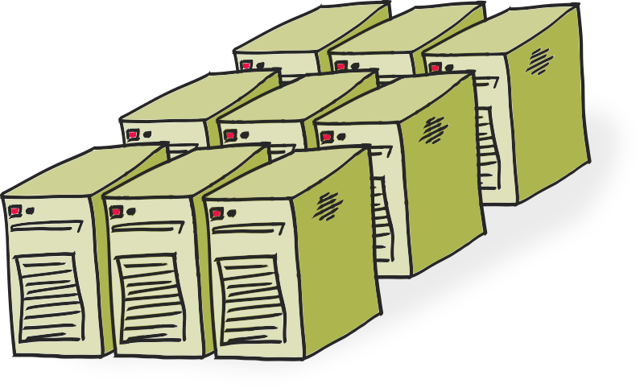
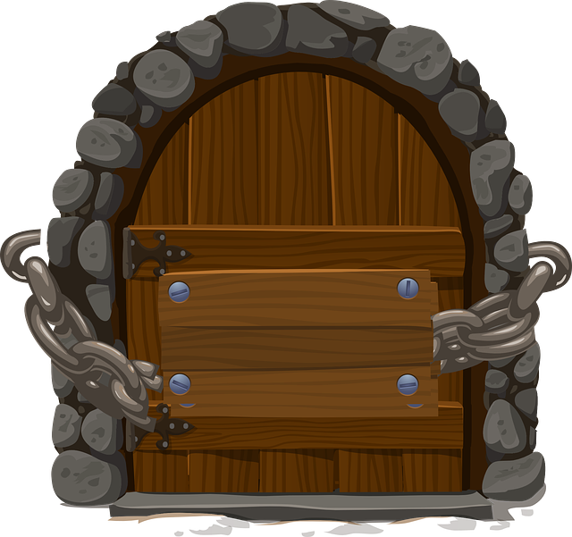
Physical Control Example
A physical control might be something as simple as locking a server room and limiting who has keys.
Server Room

Slide 8
Access Control Best Practices
Use Role-based Access Controls (RBAC)
Bob as Admin
Bob as Analyst
Bob as Data-Entry
Give each role only the access necessary
Data Entry
Analytics
Management
Bob, are you still doing data-entry?
Audit users, roles, access levels for decay

Slide 9
Rules of Engagement and Access Controls
Data Governance:
is the organization and implementation of policies, procedures, structure, roles, and responsibilities that outline and enforce rules of engagement, decision rights, and accountabilities for the effective management of information assets
- John Ladley, Danette McGilvray, Anne-Marie Smith, Gwen Thomas (McGilvray, p. 52)
But if you have weak business rules about who can access data and how…
… your access controls will be weak too!
Exactly.

Slide 10
Rules of Engagement and Access Controls
Data Governance:
is the organization and implementation of policies, procedures, structure, roles, and responsibilities that outline and enforce rules of engagement, decision rights, and accountabilities for the effective management of information assets
- John Ladley, Danette McGilvray, Anne-Marie Smith, Gwen Thomas
Or let’s go back to privacy. Restricting PII to a single DB is no good if…
… you have no idea who can access the DB!
You’re catching on!

Slide 11
Accountability and Audit
Data Governance:
is the organization and implementation of policies, procedures, structure, roles, and responsibilities that outline and enforce rules of engagement, decision rights, and accountabilities for the effective management of information assets
- John Ladley, Danette McGilvray, Anne-Marie Smith, Gwen Thomas (McGilvray, p. 52)
Similarly, without effective accountability in an organization, audits will also not be effective.
I see that…

Slide 12
Accountability and Audit
Data Governance:
is the organization and implementation of policies, procedures, structure, roles, and responsibilities that outline and enforce rules of engagement, decision rights, and accountabilities for the effective management of information assets
- John Ladley, Danette McGilvray, Anne-Marie Smith, Gwen Thomas (McGilvray, p. 52)
Suppose an audit reveals that PII was retained incorrectly. If no one is accountable…
It won’t change.

Slide 13
Key Management
Data Governance:
is the organization and implementation of policies, procedures, structure, roles, and responsibilities that outline and enforce rules of engagement, decision rights, and accountabilities for the effective management of information assets
- John Ladley, Danette McGilvray, Anne-Marie Smith, Gwen Thomas (McGilvray, p. 52)
On a related note, what do you know about
key management or the
key lifecyle?
Not a dang thing…

Slide 14
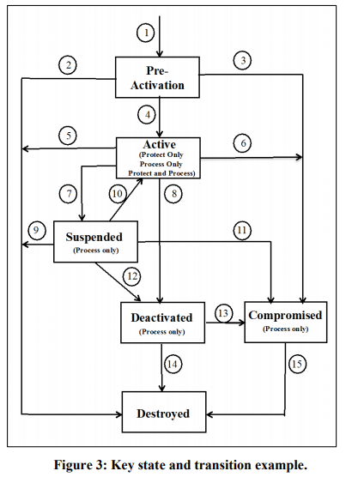
Data-at-Rest Key Management
Key management is always the hardest, weakest part of Crypto
Keys have a lifecycle
For at-rest, rotation required.
Should be audited
From NIST SP 800-57 Pt. 1 Rev 4.

Slide 15
Key Management Best Practices
Keep keys separated from the data
Store master keys in a Hardware Security Module (HSM)
Do not keep HSM’s with master keys connected to the network
Consider a complete, automated key management solution
Consider splitting keys to sensitive data using m-of-n sharing

Slide 16
Decision Rights and Key Management
Data Governance:
is the organization and implementation of policies, procedures, structure, roles, and responsibilities that outline and enforce rules of engagement, decision rights, and accountabilities for the effective management of information assets
- John Ladley, Danette McGilvray, Anne-Marie Smith, Gwen Thomas (McGilvray, p. 52)
But if you don’t know who should have a key, for how long, or for what purpose…
… then what good is key management?
Indeed.

Slide 17
Not Done Yet!
Data Governance:
is the organization and implementation of policies, procedures, structure, roles, and responsibilities that outline and enforce rules of engagement, decision rights, and accountabilities for the effective management of information assets
- John Ladley, Danette McGilvray, Anne-Marie Smith, Gwen Thomas (McGilvray, p. 52)
Bob, much of our discussion on “governance” has focused on users. But what about the data itself?
I don’t follow.

Slide 18
What’s the problem here?
Remember in our PII discussion what we said about data inputs?
Yes, you said to only admit PII from authorized entry points.
Do you see what assumption that approach depends on?
Uh… no?
That you know all of your data entry points.

Slide 19
Where is the Data?!
Do you know where the data is in your system?
By system, I mean the entire business “system”.
Do you know if you have any duplication?
Do you know all the sources of a given piece of data?
Do you know how a given piece of data is shared?
Do you know how data is disposed of?
YOU CAN’T SECURE WHAT YOU DON’T KNOW

Slide 20
Information Quality
Information Quality:
is the degree to which information and data can be a trusted source for… all required users. It is having the right set of correct information, at the right time, in the right place, for the right people…
- McGilvray, p.5, emphasis added.
An organization with low data quality will, almost certainly, have poor data security and privacy.
Got it!

Slide 21
Correlation from the Security World
“many systems fail because their designers protect the wrong things, or protect the right things but in the wrong way.”
Ross Anderson, Security Engineering, 2nd Ed.,

Slide 22
Dr. Nielson’s Version:
“many systems fail because their designers protect the wrong data, or protect the right data but in the wrong way…
… at least in part because they don’t know what data they have, how correct it is, where it came from, and what it’s used for…”

Slide 23
Data Quality Again.
I highly recommend Executing Data Quality Projects: Ten Steps to Quality Data and Trusted Information™ by Danette McGilvray
The book describes Danette’s Ten Step process for Quality Data
To repeat, an organization without information quality is almost certainly going to be without information security
In my opinion, a data quality analysis must be included in any kind of data security analysis
Let’s take a look at Danette’s acronym “POSMAD”

Slide 24
POSMAD
POSMAD (Information Life Cycle):
P – Plan for data M – Maintain data
O – Obtain data A – Apply data
S – Store/share data D – Dispose data
- McGilvray p.23 (adapted from English pp. 200–209).
Alright, Bob, this is POSMAD, an acronym for the information lifecycle. We’re going to customize it for security/privacy
I’m ready.

Slide 25
Prepare Security & Privacy for the Resource
POSMAD (Information Life Cycle):
P – Plan for data M – Maintain data
O – Obtain data A – Apply data
S – Store/share data D – Dispose data
- McGilvray p.23 (adapted from English pp. 200–209).
In the plan phase, you identify your data’s security and privacy requirements. Then you design and implement controls.
So, what kind of encryption to use?
… no…

Slide 26
Plan – Measure Once, Cut Twice
Encryption is probably the last thing to think about.
What are the security/privacy requirements of the data?
Upon entry?
Upon exit?
While in custody of your organization?
Disposal?
Who will have access to the data?
Will access to the data require keys? How will keys be managed?
What are the regulatory requirements?
What are the ethical obligations?

Slide 27
Obtain the Data Securely
POSMAD (Information Life Cycle):
P – Plan for data M – Maintain data
O – Obtain data A – Apply data
S – Store/share data D – Dispose data
- McGilvray p.23 (adapted from English pp. 200–209).
Boundaries are often where things go wrong in security/privacy.
Doors and windows are always vulnerable
Right.

Slide 28
Data in Motion Again!
Securely collecting data usually comes in one of two ways: already secured or raw “sensor” input.
External Secure Boundary
Internal Secure Boundary
Transmission
I guess this example is the first of those two?

Slide 29
Security is Always About Context
Yes, the biggest problem is different security contexts. The external boundary assumes different things
External Secure Boundary
Internal Secure Boundary
Transmission
So something that was secure in one context isn’t secure in the other?

Slide 30
PII Boundary Issue
Contexts can be different for many reasons including regulatory environment. When bringing in data, make sure the security assumptions for both sides are understood and documented
Here’s a privacy example. Data is Linkable PII externally, but when it enters our system becomes Linked
External Secure Boundary
Internal Secure Boundary
Transmission
PII
I see. We have more data than the external party. We have bigger privacy issues.

Slide 31
Store/Share Data Securely
POSMAD (Information Life Cycle):
P – Plan for data M – Maintain data
O – Obtain data A – Apply data
S – Store/share data D – Dispose data
- McGilvray p.23 (adapted from English pp. 200–209).
Once you get data into the system, you have to control where it is…
… and who can access it. We’ve already talked about this
It won’t hurt to repeat.

Slide 32
Security and Privacy in Sharing and Storing
Ensure that all locations where the data is stored are known
Watch out for hidden storage locations such as cache/replication
Ideally, store it in just one location if at all possible
Ensure that equivalent security controls are used in all locations
Don’t require 2FA auth on the DB and leave a hard copy unsecured!
Ensure that equivalent access controls are used in all locations
Use Role-based Access Controls and minimize access
For external access/sharing, review security context changes

Slide 33
Continuously Ensure the Security of the Data
POSMAD (Information Life Cycle):
P – Plan for data M – Maintain data
O – Obtain data A – Apply data
S – Store/share data D – Dispose data
- McGilvray p.23 (adapted from English pp. 200–209).
Bob, have you heard of Data Decay?
Of course.
Unfortunately, security also “decays”. Thus, security must be maintained.

Slide 34
Security Decay
How does security “decay”?
Sources of Security Decay:
New OS/App vulnerabilities
New crypto guidance
Key lifetime expirations
Certificate expirations
Staff turnover
New/updated applications
New/updated regulations
Corruption/mistakes in config
Bugs
Changes in requirements
Changes in risk profile, tolerance
Complacency over time
Aggregation of minor issues
Data decay
Access controls decay
There are a lot of reasons. Here are a few:

Slide 35
Security Decay Painful Example
Remember the Equifax breach? They didn’t patch a server they knew was vulnerable
Sources of Security Decay:
New OS/App vulnerabilities
New crypto guidance
Key lifetime expirations
Certificate expirations
Staff turnover
New/updated applications
New/updated regulations
Corruption/mistakes in config
Bugs
Changes in requirements
Changes in risk profile, tolerance
Complacency over time
Aggregation of minor issues
Data decay
Access controls decay
Ignored audits
Unmonitored logs/ignored alarms
Oof.

Slide 36
Use Data Securely (Data-in-Use!)
POSMAD (Information Life Cycle):
P – Plan for data M – Maintain data
O – Obtain data A – Apply data
S – Store/share data D – Dispose data
- McGilvray p.23 (adapted from English pp. 200–209).
And, of course, you must use data securely.
How do you do that?
In many ways, it’s a microcosm of all the other elements we’ve discussed.

Slide 37
Visualizing Secure Data Use (1)
As with the “obtain” step, ensure that the data is securely transmitted to the application.
Data at Rest
Application
(Data-in-Use)
Data in Motion
Let me guess, the issues with “context” still apply. It could be secure on-disk, but not in the application.

Slide 38
Visualizing Secure Data Use (2)
Correct. An application might bring together PII, or a key and encrypted data, etc.
Data-at-Rest
Application
(Data-in-Use)
Data in Motion
The security constraints of both the data and the application need to be understood and documented.

Slide 39
Visualizing Secure Data Use (3)
Well, that makes sense. But I don’t see how “share/store” and “maintain” apply.
Application
(Data-in-Use)
They do. An application should only be able to communicate the data with authorized users and programs. And, of course, not store the secure data in an unknown/unauthorized location

Slide 40
Visualizing Secure Data Use (4)
And maintain?
Application
(Data-in-Use)
Use audits, monitoring, etc. to ensure the correct operation. Review data logs and alerts. And, of course, check with the vendor for patches.

Slide 41
Secure Data Disposal
POSMAD (Information Life Cycle):
P – Plan for data M – Maintain data
O – Obtain data A – Apply data
S – Store/share data D – Dispose data
- McGilvray p.23 (adapted from English pp. 200–209).
Last, but not least, secure data disposal.
Like with the hard drive?
That’s media disposal. This is a more holistic process.

Slide 42
Possible Elements of Secure Data Destruction
Ensure that all copies of the data are accounted for
Revoke all access
Terminate any processes using the data
Ensure remote device usage is also accounted for
Include physical copies in the accounting
Securely delete data; use cryptographic shredding or overwriting
Document the destruction if required by policy or regulation
Release keys, access controls, etc associated with the data
Release metadata or other data no longer needed

